Slide 1
Struts 2.0 Basics 1/2

Slide 2
Agenda
Overview, Architecture
Struts2 by Example
Struts.xml, web.xml, resources...
OGNL
Actions
Run Example

Slide 3
Overview & Architecture

Slide 4
Overview
Struts2 is popular and mature web application framework based on the MVC design pattern.
The WebWork framework started off with Struts framework as the basis and its goal was to offer an enhanced and improved framework built on Struts to make web development easier for the developers.
- After some time, the Webwork framework and the Struts community joined hands to create the famous Struts2 framework.

Slide 5
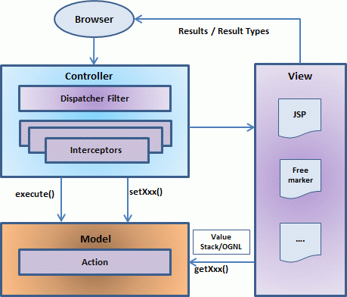
Architecture
Is a pull-MVC framework. MVC pattern in Struts2 is realized with following five core component:
Actions
Interceptors
Value Stack / OGNL
Results / Result types
View technologies
Notes:
Request life cycle:
Based on the above diagram, one can explain the user's request life cycle in Struts 2 as follows:
User sends a request to the server for requesting for some resource (i.e pages).
The FilterDispatcher looks at the request and then determines the appropriate Action.
Configured interceptors functionalities applies such as validation, file upload etc.
Selected action is executed to perform the requested operation.
Again, configured interceptors are applied to do any post-processing if required.
Finally the result is prepared by the view and returns the result to the user.

Slide 6
Struts2 by Example

Slide 7
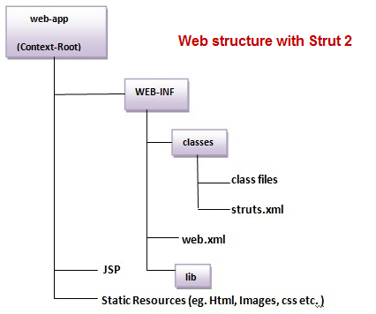
Struts2 Web Structure
Using Eclipse to create a Dynamic Web Project

Slide 8
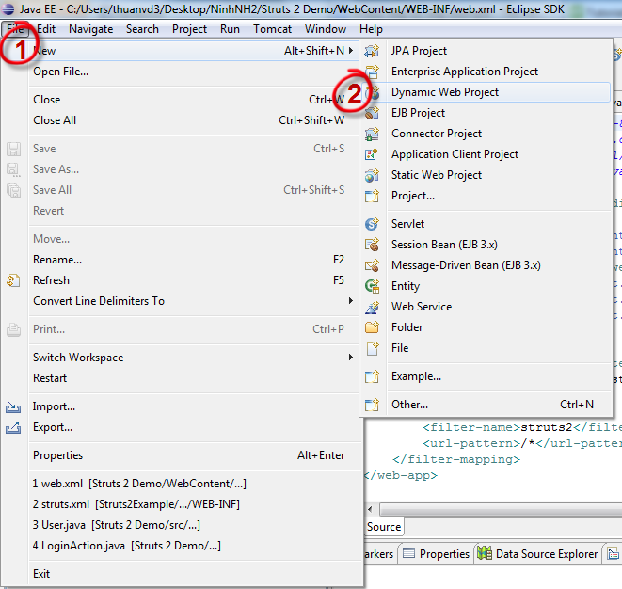
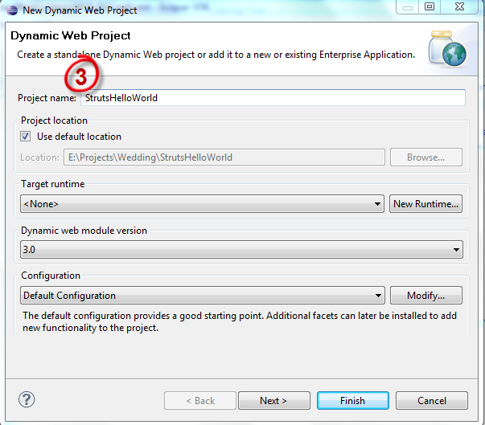
Create Dynamic Web
Web Application: StrutsHelloWorld

Slide 9
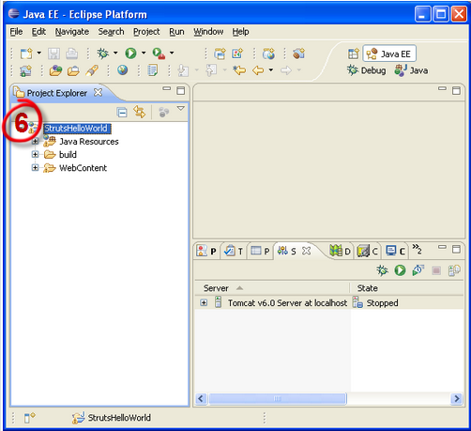
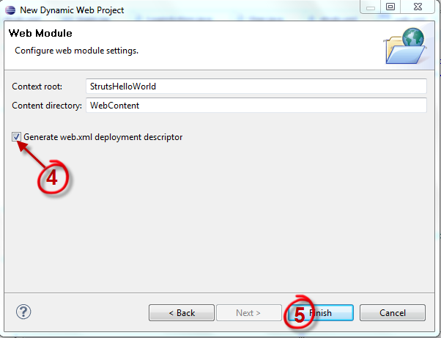
Create Dynamic Web

Slide 10
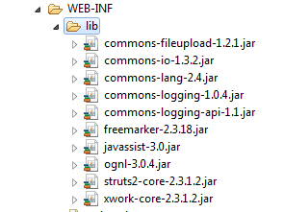
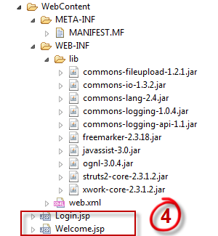
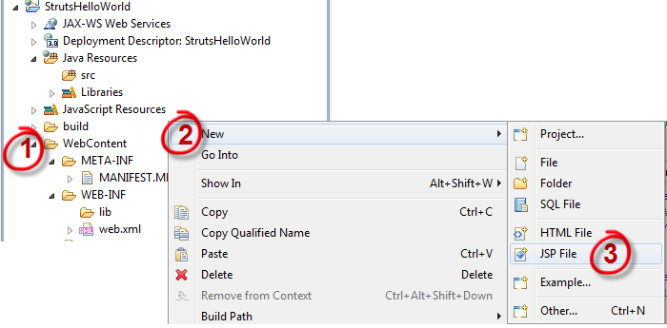
Create JSPs
Using Jar Libs:
- Jar files import to WEB-INF/lib folder
Create 2 jsp file in WebContent:
- Login.jsp
- Welcome.jsp

Slide 11
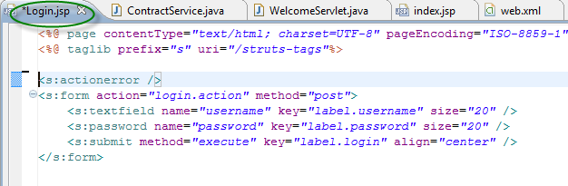
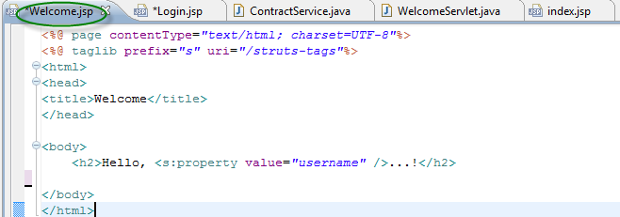
Create JSPs

Slide 12
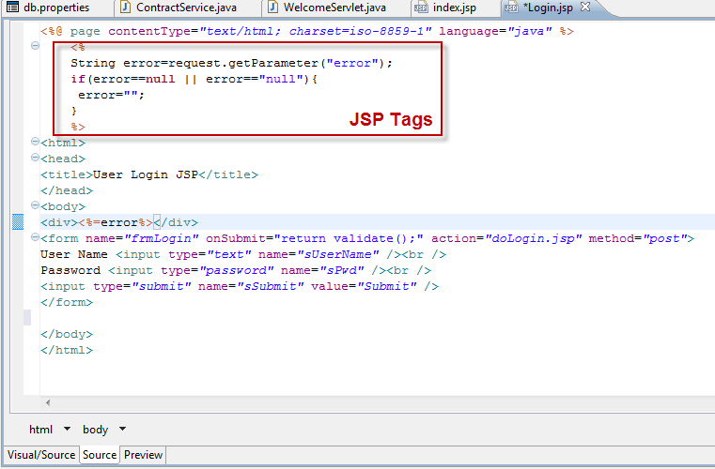
What is JSP?
- JSP (Java Server Page): is the latest Java technology for web application development and is based on the servlet technology
Insert java code in HTML by using JSP tags <% .. %>:
Notes:
- JSP (Java Server Page): is the latest Java technology for web application development and is based on the servlet technology
- Help developers insert java code in HTML pages by making use of special JSP tags, most of which start with <% and end with %>.
JSP tags can be used for: retrieving information from a database, accessing JavaBeans, passing control between pages and sharing information between requests, pages etc.

Slide 13
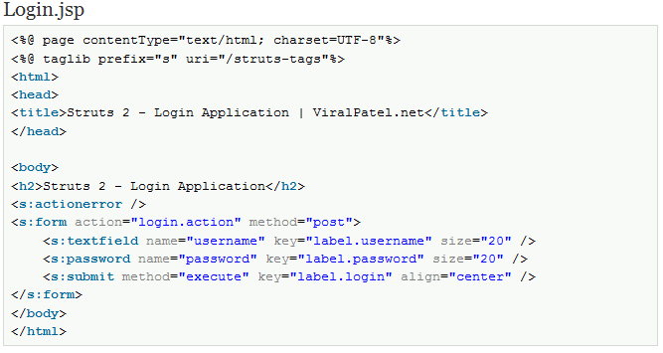
Use OGNL
Using OGNL (Object-Graph Navigation Language):
- It is an expression language for getting and setting properties of Java objects.
- Can do: parsing an expression into an internal form and then using that internal form to either set or get the value of a property
- Using :
<s:textfield…/>, <s:password…/>, <s:submit…/> in Login.jsp file.
Notes:
Login.jsp:
<%@ page contentType="text/html; charset=UTF-8"%>
<%@ taglib prefix="s" uri="/struts-tags"%>
<html>
<head>
<title>Struts 2 - Login Application | ViralPatel.net</title>
</head>
<body>
<h2>Struts 2 - Login Application</h2>
<s:actionerror />
<s:form action="login.action" method="post">
<s:textfield name="username" key="label.username" size="20" />
<s:password name="password" key="label.password" size="20" />
<s:submit method="execute" key="label.login" align="center" />
</s:form>
</body>
</html>
Welcome.jsp
<%@ page contentType="text/html; charset=UTF-8"%>
<%@ taglib prefix="s" uri="/struts-tags"%>
<html>
<head>
<title>Welcome</title>
</head>
<body>
<h2>Howdy, <s:property value="username" />...!</h2>
</body>
</html>

Slide 14
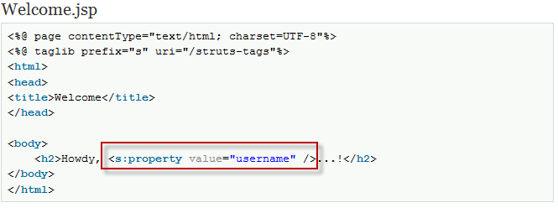
Use OGNL
Welcome.jsp file:
- Using: <s:property…/>
Notes:
<%@ page contentType="text/html; charset=UTF-8"%>
<%@ taglib prefix="s" uri="/struts-tags"%>
<html>
<head>
<title>Welcome</title>
</head>
<body>
<h2>Hello, <s:property value="username" />...!</h2>
</body>
</html>

Slide 15
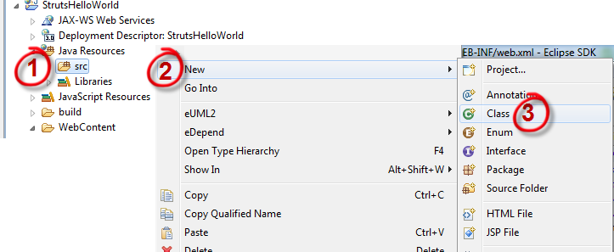
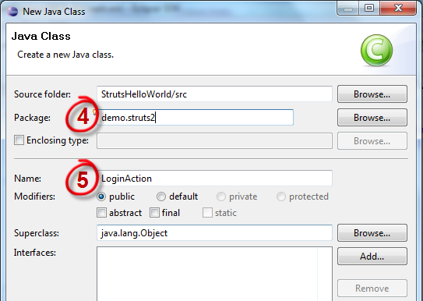
Create Action
Create an LoginAction class:
- Will authenticate user, holds the value for username and password

Slide 16
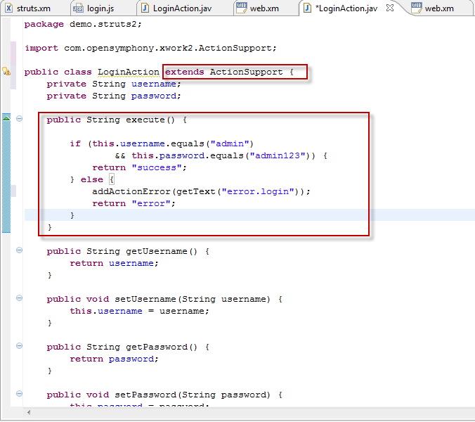
Implement Action
In LoginAction class:
Transfer of data from the request through to the view
Using set, get method to pass and hold value
The execute() method returns a String value which will determine the result page
Method execute() is the default method getting called by Sturts2
Notes:
public class LoginAction {
private String username;
private String password;
public String execute() {
if (this.username.equals("admin")
&& this.password.equals("admin123")) {
return "success";
} else {
return "error";
}
}
public String getUsername() {
return username;
}
public void setUsername(String username) {
this.username = username;
}
public String getPassword() {
return password;
}
public void setPassword(String password) {
this.password = password;
}
}

Slide 17
Implement Action
An Action can extends the ActionSupport class which implements six interfaces including Action interface. The Action interface is as follows:
public static final String SUCCESS = "success";
public static final String NONE = "none";
public static final String ERROR = "error";
public static final String INPUT = "input";
public static final String LOGIN = "login";
public String execute()
Notes:
public interface Action {
public static final String SUCCESS = "success";
public static final String NONE = "none";
public static final String ERROR = "error";
public static final String INPUT = "input";
public static final String LOGIN = "login";
public String execute() throws Exception;
}

Slide 18
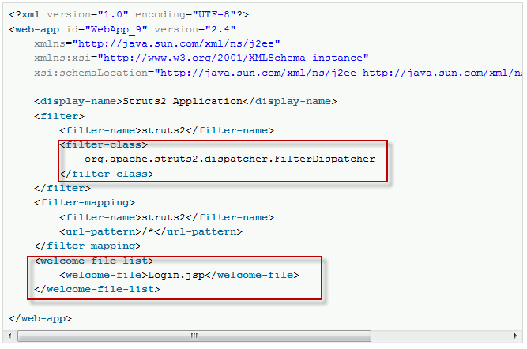
Create Web.xml
Default in WebContent/WEB-INF folder.
Mapping Struts2 in WEB.xml:
- <filter…./>: FilterDispatcher filter is called which consults the ActionMapper to determine whether an Action should be invoked.
- <welcome-file> determine the first page loading (Login.jsp)
Notes:
<?xml version="1.0" encoding="UTF-8"?>
<web-app id="WebApp_9" version="2.4"
xmlns="http://java.sun.com/xml/ns/j2ee"
xmlns:xsi="http://www.w3.org/2001/XMLSchema-instance"
xsi:schemaLocation="http://java.sun.com/xml/ns/j2ee http://java.sun.com/xml/ns/j2ee/web-app_2_4.xsd">
<display-name>Struts2 Application</display-name>
<filter>
<filter-name>struts2</filter-name>
<filter-class>
org.apache.struts2.dispatcher.FilterDispatcher
</filter-class>
</filter>
<filter-mapping>
<filter-name>struts2</filter-name>
<url-pattern>/*</url-pattern>
</filter-mapping>
<welcome-file-list>
<welcome-file>Login.jsp</welcome-file>
</welcome-file-list>
</web-app>

Slide 19
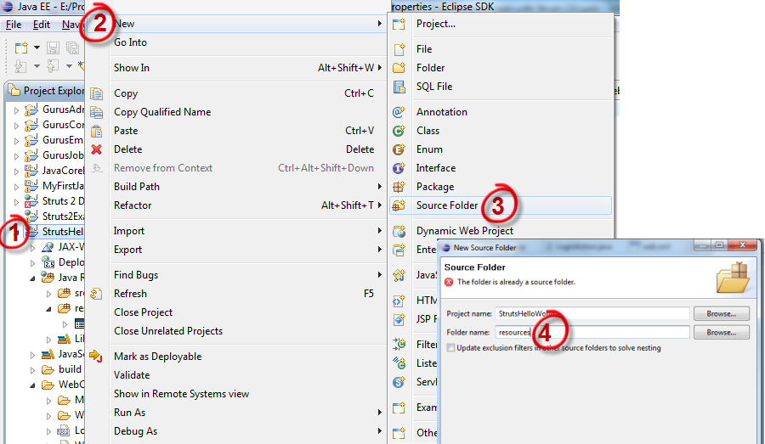
Create ResourceBundle
Helps in putting the static content away from the source file
- Create resources folder:

Slide 20
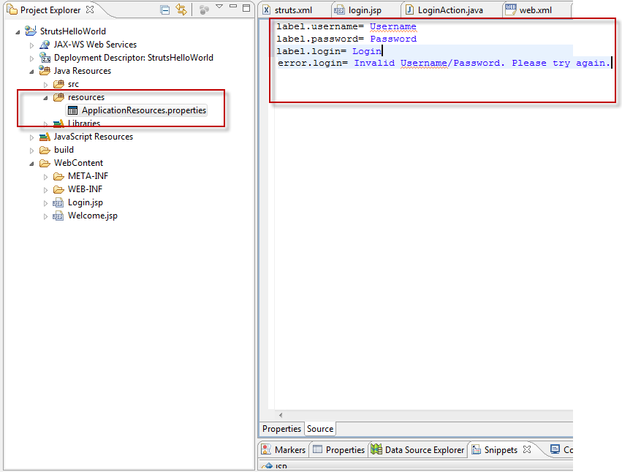
Create ResourceBundle
Create a ApplicationResources.properties under resources folder
Define static content :
label.username
lable.password
label.login
error.login
Notes:
label.username=Username
label.password=Password
label.login=Login
error.login=Invalid Username/Password. Please try again.

Slide 21
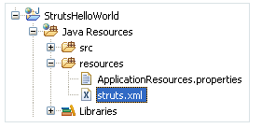
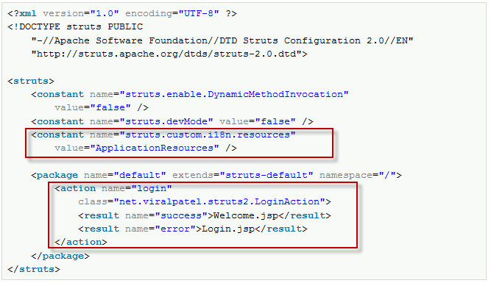
Create Struts.xml
Create a file struts.xml under resources folder:
- Struts.xml Configuration:
Notes:
<?xml version="1.0" encoding="UTF-8" ?>
<!DOCTYPE struts PUBLIC
"-//Apache Software Foundation//DTD Struts Configuration 2.0//EN"
"http://struts.apache.org/dtds/struts-2.0.dtd">
<struts>
<constant name="struts.enable.DynamicMethodInvocation"
value="false" />
<constant name="struts.devMode" value="false" />
<constant name="struts.custom.i18n.resources"
value="ApplicationResources" />
<package name="default" extends="struts-default" namespace="/">
<action name="login"
class="demo.struts2.LoginAction">
<result name="success">Welcome.jsp</result>
<result name="error">Login.jsp</result>
</action>
</package>
</struts>

Slide 22
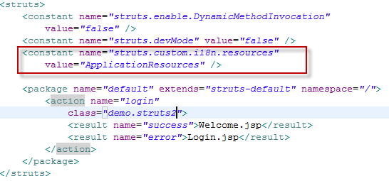
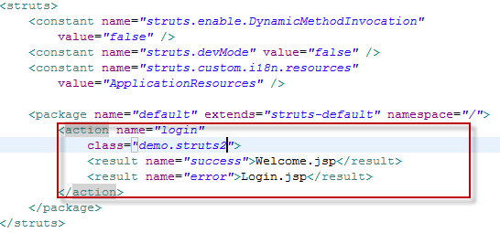
Struts.xml Configuration
<constant../>: Help application to determine and read content text in ApplicationResources.properties file.
<action../>: Application determines what Action class to call by requesting
<result…/>: Forward to a servlet, JSP, HTML page… after Action class executed.
Notes:
<?xml version="1.0" encoding="UTF-8" ?>
<!DOCTYPE struts PUBLIC
"-//Apache Software Foundation//DTD Struts Configuration 2.0//EN"
"http://struts.apache.org/dtds/struts-2.0.dtd">
<struts>
<constant name="struts.enable.DynamicMethodInvocation"
value="false" />
<constant name="struts.devMode" value="false" />
<constant name="struts.custom.i18n.resources"
value="ApplicationResources" />
<package name="default" extends="struts-default" namespace="/">
<action name="login"
class="demo.struts2.LoginAction">
<result name="success">Welcome.jsp</result>
<result name="error">Login.jsp</result>
</action>
</package>
</struts>

Slide 23
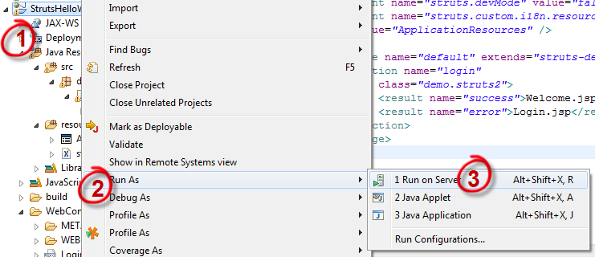
Run Application
Running by “Run on Server”

Slide 24
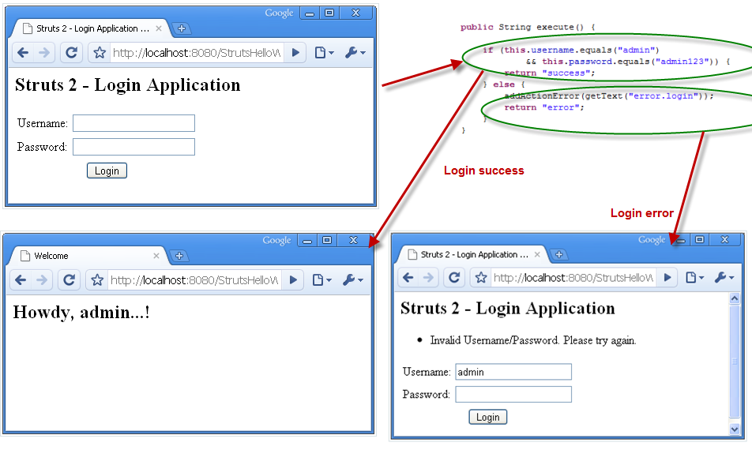
Run Application

Slide 25
Struts 2 framework features
POJO forms, POJO actions | Can use any POJO to receive the form input and POJO as an Action class.
Tag support | Has improved the form tags, new tags allow the developers to write less code.
AJAX support | Integrated AJAX by creating AJAX tags, very similar to the standard Struts2 tags.
Easy Integration | Integration with other frameworks like Spring, Tiles and SiteMesh is now easier with a variety of integration available with Struts2.
Template Support | Support for generating views using templates.
Plugin Support | can be enhanced and augmented by the use of plugins. A number of plugins are available for Struts2.
Profiling | Integrated profiling to debug and profile the application Integrated debugging with the help of built in debugging tools.
Easy to modify tags | Can be tweaked using Freemarker templates. This does not require JSP or java knowledge. Basic HTML, XML and CSS knowledge is enough to modify the tags.
View Technologies | Great support for multiple view options (JSP, Freemarker, Velocity and XSLT)

Slide 26
Summary
- Struts2: a web application framework based on the MVC
- Support POJO Action, execute() is the default method getting called by Sturts2
- Action class can extend Support Action
- Use OGNL to set, get value
Use ResourceBundle to help in putting the static content away from the source file

Slide 27
Q & A

